Slide 1
Building Clustering Models
Build k-Means Clustering Models
Build Hierarchical Clustering Models

Slide 2

Build k-Means Clustering Models

Slide 3
k-Means Clustering (Slide 1 of 2)
Centroids
1.0
0.0
0.0
1.0

Slide 4
k-Means Clustering (Animated) (Slide 2 of 2)

Slide 5

Global vs. Local Optimization
k-means global cost function, where:
n is the total number of examples.
x_{i} is the i^{th} data example.
c_{j} is the j^{th} centroid.
Not feasible to apply globally.
If you tried all possible assignments of n, you'd end up with too many combinations.
Example: n = 25, number of clusters = 4, there are ~47 trillion assignments.
k-means requires a local optimization process:
Takes number of desired clusters and randomly assigns centroids.
Assigns example to its currently closest centroid.
Moves centroid so it's in the center of data examples assigned to it.
Repeats until convergence or max iteration count is met.
More efficient, but doesn't always achieve perfect global optimization.
You can re-initialize k-means with different randomly chosen centroids.
$$J\left(θ\right)=\sum_{i=1}^{n}{\min_{j}\left(dist\left(x_{i}, c_{j}\right)\right)}$$

Slide 6
k Determination
Primary challenge is determining the number of clusters.
Several metrics can help.
Before using the metrics, you should assess the problem you're trying to solve.
You may be able to place constraints based on domain knowledge.
Example: dataset of different fruits with various features.
You know each example is one of three possible fruits.
You would only accept three clusters.
No need to rely on metrics to determine number of clusters.

Slide 7
Elbow Point
50
Mean Distance to Centroid
Elbow point
0
1
2
3
4
5
k (Num. of Clusters)

Slide 8
Cluster Sum of Squares
Two ideal properties of a clustering model:
Compactness of the cluster.
How well separated the cluster is from other clusters.
You can evaluate these properties separately.
Within-cluster sum of squares (WCSS):
Measures compactness.
Measures distance between data point and its centroid.
Repeats process for all points in the cluster, then calculates mean distance.
Smaller values indicate more compactness.
Between-cluster sum of squares (BCSS):
Measures separation.
Measures distance between a centroid and all other centroids.
Repeats process for all other centroids, then calculates the sum.
Large values indicate more separation.

Slide 9



Silhouette Analysis
$$k=2$$
$$k=3$$
$$k=4$$
1
1
1
Clusters
2
2
Clusters
Clusters
2
3
3
4
0.0
0.5
1.0
0.0
0.5
1.0
0.0
0.5
1.0
Silhouette Coefficient
.578
Silhouette Coefficient
.732
Silhouette Coefficient
.492

Slide 10
Additional Cluster Analysis Methods
Dunn index:
Calculate smallest distance between two data points not in same cluster.
Calculate largest distance between two data points within same cluster.
Calculate ratio of values.
Indicates good cluster compactness and separation.
Will always be above 0 and has no maximum.
Higher values are better.
Davies–Bouldin index:
Calculates average ratio of within-cluster distance and between-cluster distance for each cluster as compared to its most similar cluster.
Indicates good cluster compactness and separation.
Will always be above 0 and has no maximum.
Lower values are better.

Slide 11

Build a k-Means Clustering Model
Use k-means for unsupervised learning to find groups of similar data points.
Apply k-means to data that is spherical or overlapping.
Consider applying domain knowledge in determining ideal k value.
Use statistical methods to determine k.
Use elbow point analysis to identify optimal k.
Use WCSS and BCSS to evaluate compactness and separation of clusters.
Use silhouette analysis to evaluate both compactness and separation together.
In silhouette analysis, consider choosing k based on highest coefficient score.
Consider using additional analysis methods.
Consider there is no objectively "correct" analysis method for all problems.
Consider that different methods may give different results for optimal k value.

Slide 12
Use Python for k-Means Clustering
Use scikit-learn's Kmeans() class to build k-means clustering models:
model = sklearn.cluster.KMeans(n_clusters = 3)
model.fit(X_train)
model.fit_predict(X_train)
model.predict(X_test)
sklearn.metrics.silhouette_score(X_train, clusters)
sklearn.metrics.silhouette_samples(X_train, clusters)
Use a third-party library like Yellowbrick to generate elbow point graph:
visualizer = yellowbrick.cluster.KElbowVisualizer(model, k = (1, 10))
visualizer.fit(X_train)

Slide 13
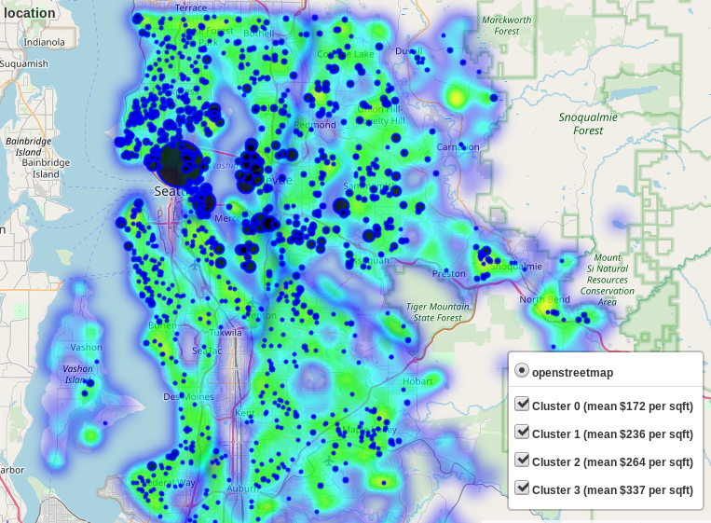
Activity: Building a k-Means Clustering Model
The real estate company has prospective buyers for houses in King County.
Each buyer identifies what houses they are most interested in.
Unfortunately, these houses aren't always available.
The real estate agent will need to recommend similar houses.
Not easy to determine what is similar.
Even though this dataset is labeled, it can be used to solve another type of problem.
You'll group houses together based on feature similarity.
You'll use k-means clustering to do this.

Slide 14

Activity: (Optional) Building a Clustering Model for Customer Segmentation
Mixed Messages Media does marketing for a large wholesale distributor.
Distributor sells many kinds of products to retailers, including food.
You need to help distributor with customer segmentation.
They need to target retailers to maximize sales.
You have a historical dataset of spending figures for each retail client in different product categories.
The data has no label, so you'll need to use clustering to assign clients to groups.

Slide 15
Build Hierarchical Clustering Models

Slide 16
k-Means Clustering Shortcomings (Slide 1 of 2)
1.0
0.0
0.0
1.0

Slide 17
k-Means Clustering Shortcomings (Slide 2 of 2)
Initial Centroids
Converged Centroids
1.0
1.0
0.0
0.0
1.0
0.0
0.0
1.0

Slide 18
Hierarchical Agglomerative Clustering (Two Clusters)
First Iteration
Second Iteration
Third Iteration
Fourth Iteration

Slide 19
Hierarchical Agglomerative Clustering (Three Clusters)
First Iteration
Second Iteration
Third Iteration
Fourth Iteration

Slide 20
Hierarchical Clustering Applied to a Spiral Dataset
1.0
0.0
0.0
1.0

Slide 21
When to Stop Hierarchical Clustering
Without stopping criteria, HAC will eventually merge all examples into one cluster.
HDC will keep splitting until each example is by itself.
You need a point at which to stop the hierarchy from continuing.
Helps to have domain knowledge to dictate number of clusters.
When you're not so lucky, you can use some of the same techniques as k-means:
Silhouette analysis, Dunn index, etc.

Slide 22
Dendrogram (Slide 1 of 2)
5
0
4
3
5
6
1
2

Slide 23
Dendrogram (Slide 2 of 2)
5
3 clusters
0
4
3
5
6
1
2

Slide 24
Build a Hierarchical Clustering Model
Use hierarchical clustering on data that is well separated.
Consider HAC over HDC for simplicity, but consider HDC to maximize clustering skill.
Consider applying domain knowledge to cluster stopping point.
Use some of the same analysis techniques discussed earlier.
Create a dendrogram with a cutoff point to help determine number of clusters.
To determine cutoff, calculate the distance of the longest branch before it merges.
For complex dendrograms, consider using a dynamic cutting method.

Slide 25
Use Python for Hierarchical Agglomerative Clustering
Use scikit-learn's AgglomerativeClustering() class to build an HAC model:
model = sklearn.cluster.AgglomerativeClustering(n_clusters = 3, linkage = 'ward')
Use the same fit() and fit_predict() methods as before, as well as applicable metrics methods.
Use third-party libraries like Yellowbrick to generate visualizations.
Plot a dendrogram using SciPy's hierarchy module:
linkage = scipy.cluster.hierarchy.linkage(X_train, method = 'ward')
scipy.cluster.hierarchy.dendrogram(Z = linkage)

Slide 26
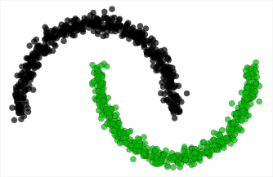
Activity: Building a Hierarchical Clustering Model
You're presented with another unsupervised dataset.
This one has data that is well separated.
k-means might not work as well with this one.
You'll compare it to a HAC model.
You'll then evaluate the number of clusters in the model.

Slide 27
What type of data in your organization do you think might be conducive to clustering analysis?
What types of clustering evaluation metrics do you think you'll rely on most to determine the optimal number of clusters? Why?

